Slide 1
A PRESENTATION ON ONLINE EXAMINATION PROJECT SWAROOP KUMAR SAHU
MC2215
DEPARTMENT OF COMPUTER SCIENCE
Berhampur university, odisha

Slide 2
PROJECT CONTEXT

Slide 3
BACKGROUND TERMS TO BE EXPLAINED:
WATERFALL MODEL
AGILE MODEL
SCRUM
SPRINT
STORY
BACKLOG
PROJECT ARCHETECTURE
JAVA BEANS
DESIGN PATTERNS
MAVEN (Application Build Tool)
PROJECT DIRECTORY STRUCTURE

Slide 4
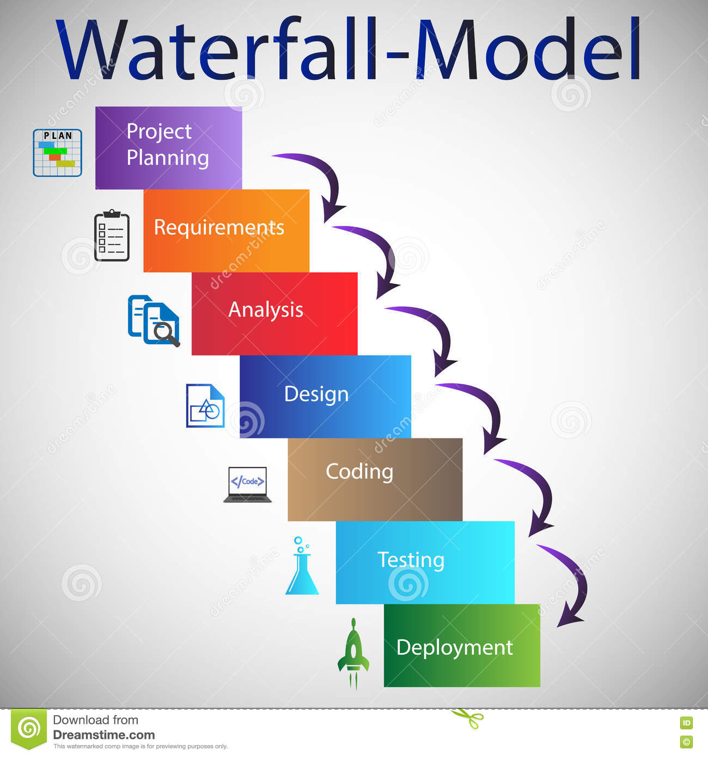

Slide 5
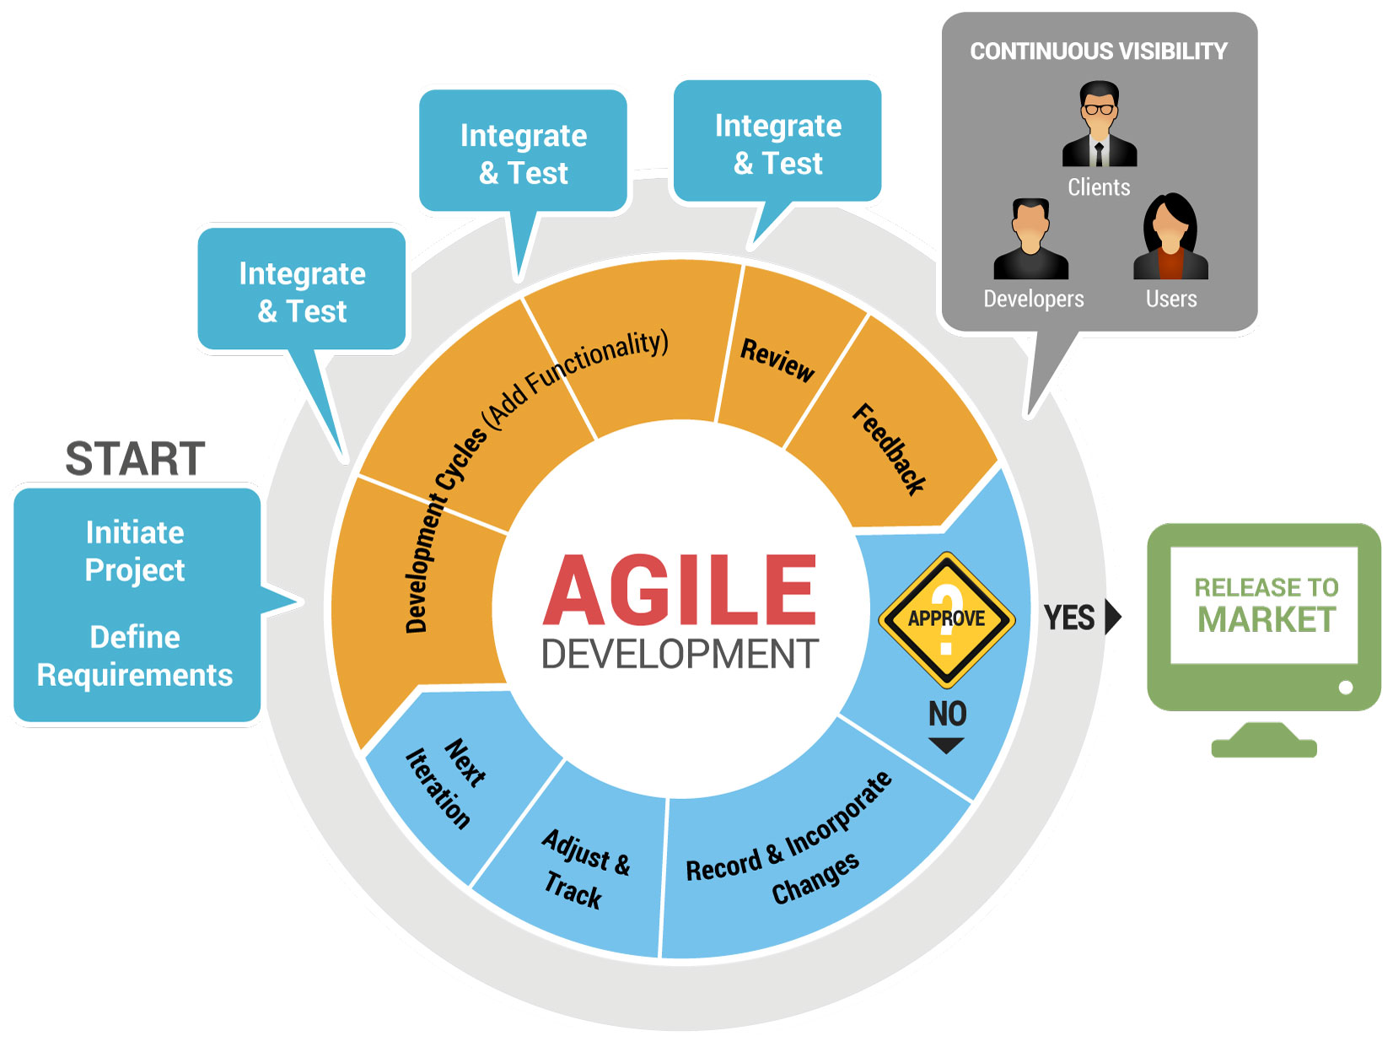

Slide 6
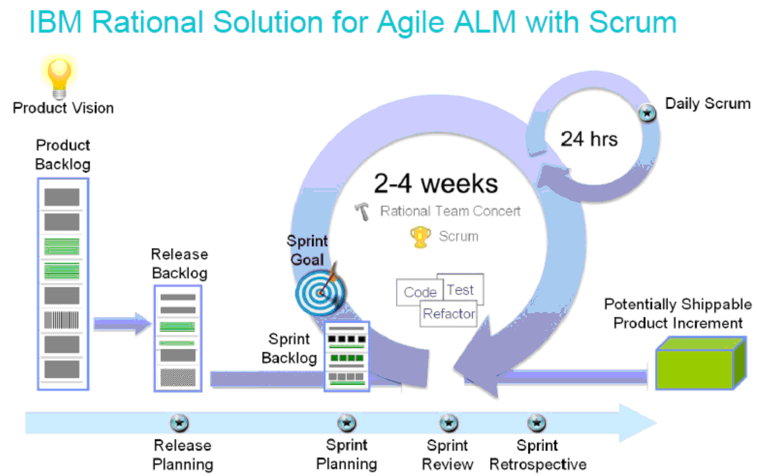

Slide 7
Project Architecture

Slide 8
Java Beans
JavaBeans are classes that encapsulate many objects into a single object (the bean). They are Serializable, have a zero-argument constructor, and allow access to properties using getter and setter methods.
Used Java Beans in my project are:
Value Object (VO)
Data Transfer Object (DTO)
Business Object (BO)
Data Access Object (DAO)

Slide 9
Design Patterns/Strategies
Design Patterns are set of rules which come as best solutions for reoccurring problems of application development.
Used Strategy Patterns in my project are:
Factory Methods(Ex: Static FM, Instance FM)
Always code to interface and never code with implementations(classes)
Code should open to extension and must be closed for modification
Composite view design pattern

Slide 10
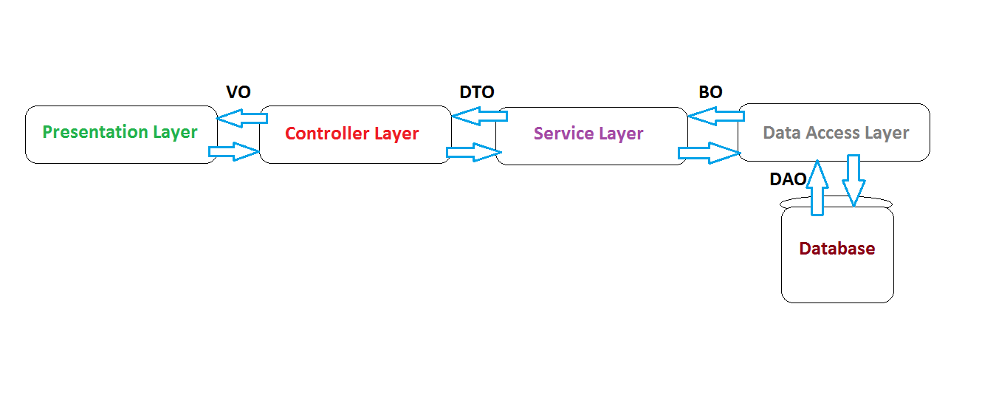
Data Flow Diagram

Slide 11
Apache Maven
An Application Build Tool
Repositories
Local Repository
Central Repository
Remote Repository
Archetype
quickstart
webapp
Dependencies

Slide 12
Project Directory Structure

